Slide 1
Research Methods
Critical Review of Research Paper
MicroPlay - Networking Framework for Local Multiplayer Games

Slide 2
Introduction
MicroPlay is a complete networking framework for local (such as Wi-Fi) multiplayer mobile games .
Main idea of this project is remove overheads of client-server architect for a small local networks and also optimized communication between client-server.
MicroPlay is based on Android framework and it provide smooth, accurate rendering of all players
One of the main challenge when developing multiplayer game is reduce game latency. When its come to local multiplayer game, it have more advantage by having more network bandwidth. By having this advantage microplay framework tries to eliminate the need for game state prediction.
By elimination of game state prediction , its significantly simplifying multi-player games development.

Slide 3
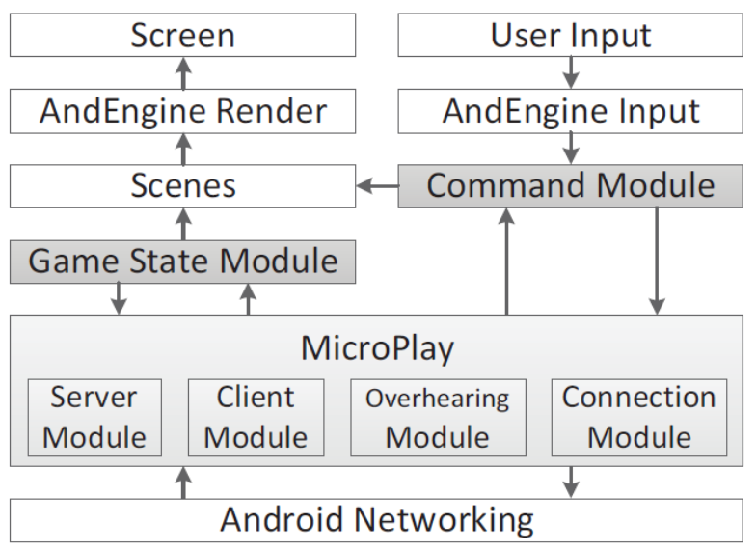
System Architecture
MicroPlay framework consists with several modules which provides/exposed interfaces to game developers to minimized their effort to build multiplayer network model.
Server & Client module works as regular way, which is client periodically samples input commands of local player and send its to server . And server periodically get a snapshot of game and sends to all clients

Slide 4
Connection module has a responsibility to setting up local network and some different responsibilities for based on server or client . For node which works as a server, it made a access point (software base) and start a DHCP server and allow to other clients to connect. Once client is connected connection module maintains TCP connection with each an every client. And also module opens a UDP socket that is subsequently used to broadcast state packets and to receive command packets.
Overhearing module is the main module in this framework to eliminate game state prediction and make game development easy and also this module helps to reduce latency by significant amount of time .
Overhearing module is basically provides an API to let each client overhear UDP command packets sent by all other clients to the server. In general server-client architect clients cannot broadcast frame . They must first send to server and server is responsible to broadcast frame to all other clients.

Slide 5
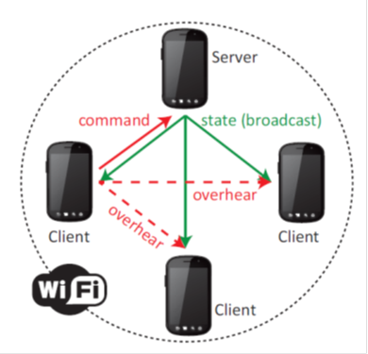
Developer must have to implement Command module which handles local player’s command and send them to execute local scene and also to a client module to send to server. Also this enables to receive overheard packets from Overhearing module and execute in local scene (As a local command)
Game state module also must provide by developer as its serialized current game state and to other client (when its works as a server).
On client phones it updates the local scene using the content of state packets received from MicroPlay framework.
That server-client approach is still to used to avoid synchronization errors and if there exist a sync error, it is quickly fixed by the subsequent state packets.

Slide 6
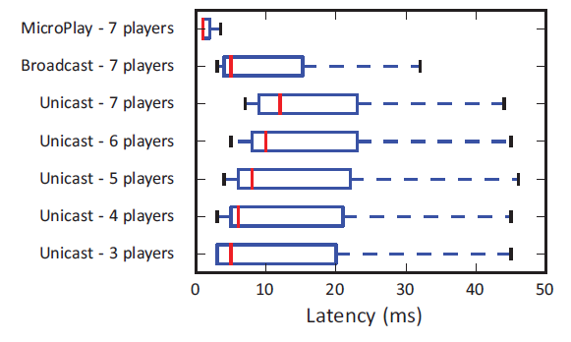
Prototyping & Example
Racer: A Multiplayer Car Racing Game
To evaluate MicroPlay framework build simple multiplayer game call “Racer”.
Racer game is based on popular android game framework call “AndEngine”. And MicroPlay is integrate to that AndEngine as a multiplayer support framework.
In evaluation Racer game run without MicroPlay framework. (As a regular client-server technique)
Then its run with another 3rd party multiplayer support framework call “AndExt “.
In benchmark clearly Microplay framework added advantage to reduce game latency.
And also game latency is lower enough for local game engine of each player to render the movements of the other players precisely, without the need for predicting the other players’ movements.

Slide 7
Evaluation – Strengths
System Architecture :- This paper described MicroPlay framework’s Architecture very well . By describing each and every module and also clearly describe how this framework interact with game engine to make game development easy.
Network Model :- Paper clearly described what are the problem people facing when they need to create network infrastructure for multiplayer games . And described how this framework solve those problems .
Prototype :- For demonstrate MicroPlay framework developers build game based on “MicroPlay” & “AndEngine” game engine called “Racer” . Which able to play with several players .
Evaluation :- To evaluate MicroPlay framework they get another multiplayer support framework and paper described what are the base differences between those framework and microplay.

Slide 8
Evaluation – Weakness
Network bandwidth:- In this paper, it is not discuss about effect of network bandwidth . Even with local network ,based on data size are transferred (This can happened with some games) this can be bottleneck . Because of overhearing, bandwidth usage is increasing exponentially when players increasing .
Other Game Engines :- This paper not describe this MicroPlay framework’s common interface to other game engines. And how to integrate with existing games with other game engines.
WLAN Data Speed:- Smartphone support deferent type WLAN standards. Some old standards have low network speeds. In this paper WLAN speed is not considered . Even one Smartphone in network have lower standards this may lead to slow entire game. With overhearing feature this factor must be considered , because of High bandwidth usage.

